Slide 1
Cryptocurrency for Energy Conscious Investors
Analysis & Comparison of Eco-Friendly Crypto Portfolio
Julia Harrison, Harry Oestreicher, & Johnny Schiliró

Slide 2
Eco-Conscious Crypto?
Problem & Background
Consensus Mechanism Explained
How do we measure Energy Consumption?

Slide 3
Proposal
Define and distinguish eco-friendly and non eco-friendly blockchain technologies
Define PoW and Pos Portfolios
Fetch and compile Historical Data
Analyze Volatility
Analyze Risk
Monte-Carlo Simulation
Hypotheses
Proof of Stake cryptocurrencies (no matter their expected use) are more environmentally friendly
than non-Proof of Stake cryptocurrencies (specifically comparing Proof of Work cryptocurrencies).
Proof of Work cryptocurrencies outperform Proof of Stake cryptocurrencies in regards to cumulative returns,
however Proof of Stake cryptocurrencies are less volatile and less risky.

Slide 4
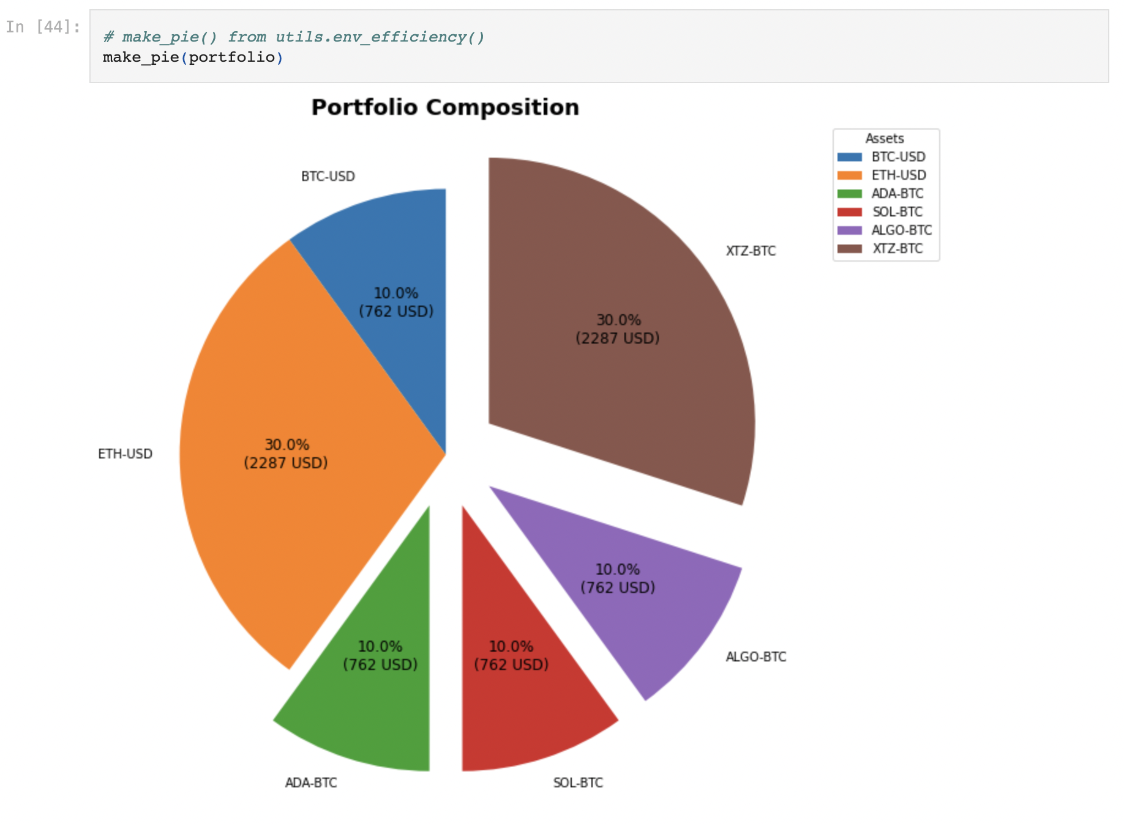
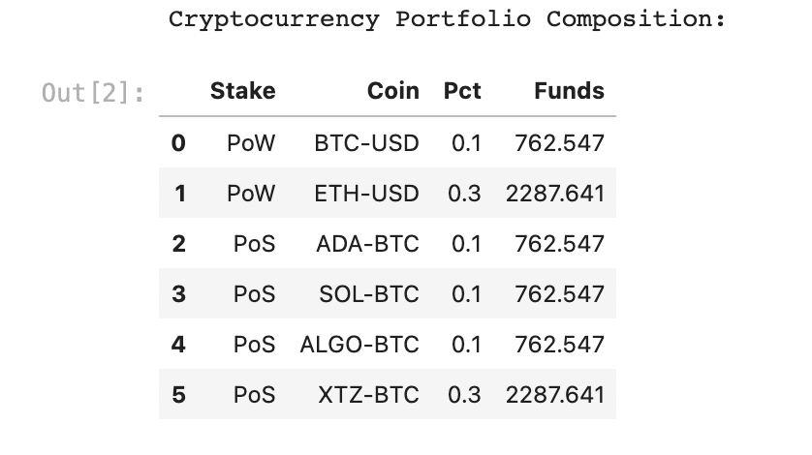
Data Collected & Explored via Coinbase

Slide 5
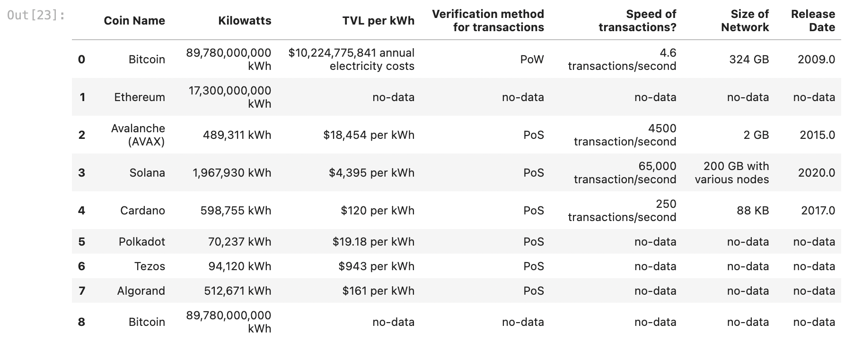
Energy & Efficiency Data Compiled

Slide 6
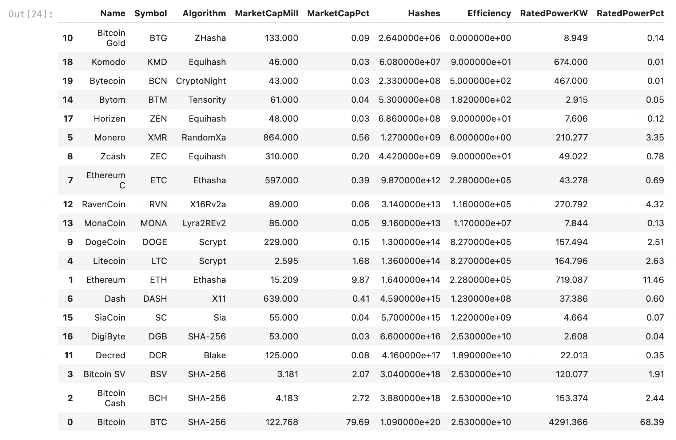
20 Mineable Cryptocurrencies

Slide 7
Crypto Picks for Comparison
PoW –
Bitcoin (BTC-USD)
Ethereum (ETH-USD)
PoS –
Solana (SOL-BTC & ETH)
Cardana (ADA-BTC & ETH)
Algorand (ALGO-BTC &ETH)
Tezos (XTZ-BTC & ETH)

Slide 8
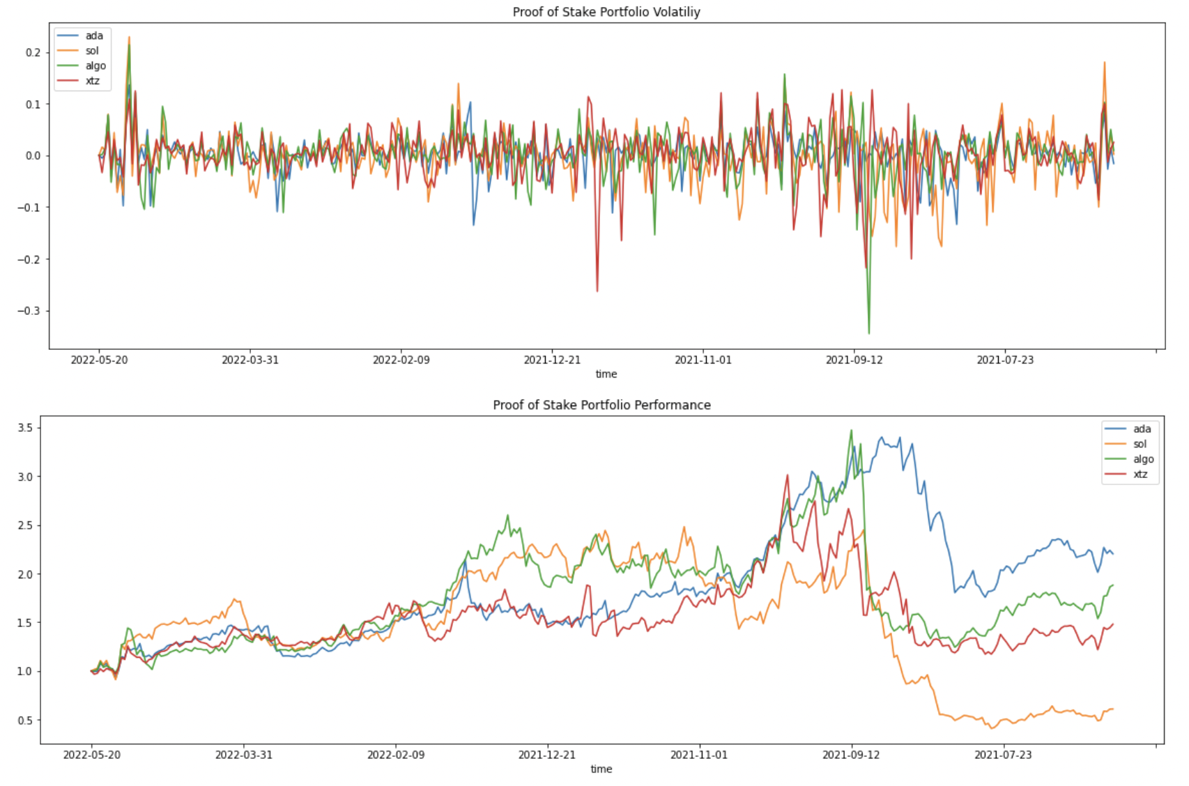
Performance & Volatility

Slide 9

Volatility Cont.
\

Slide 10
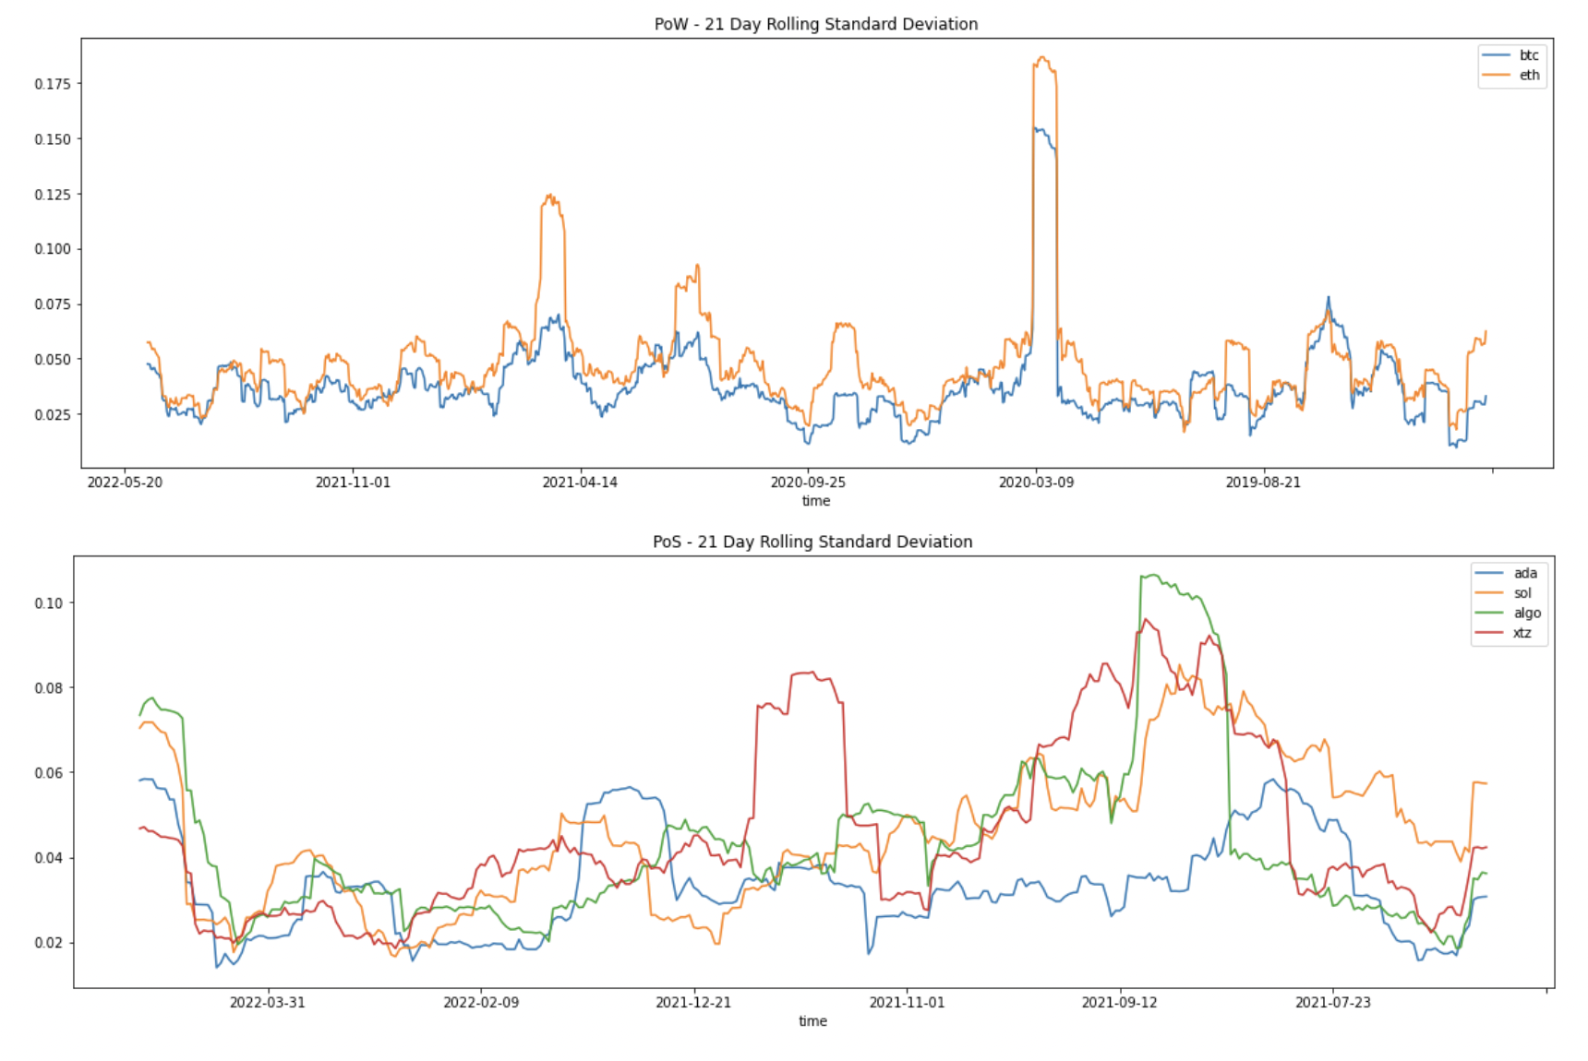
Risk

Slide 11
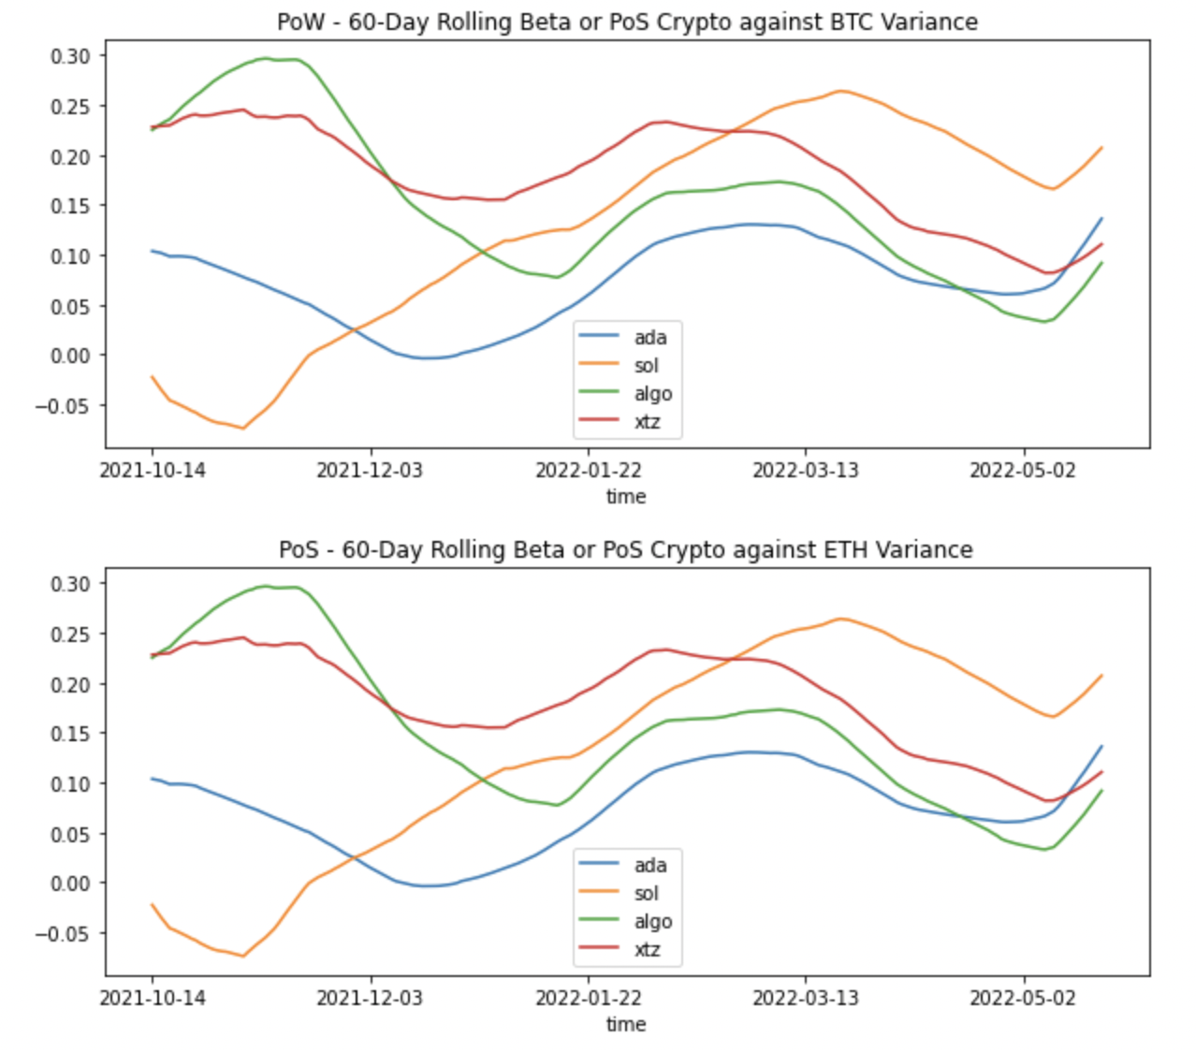
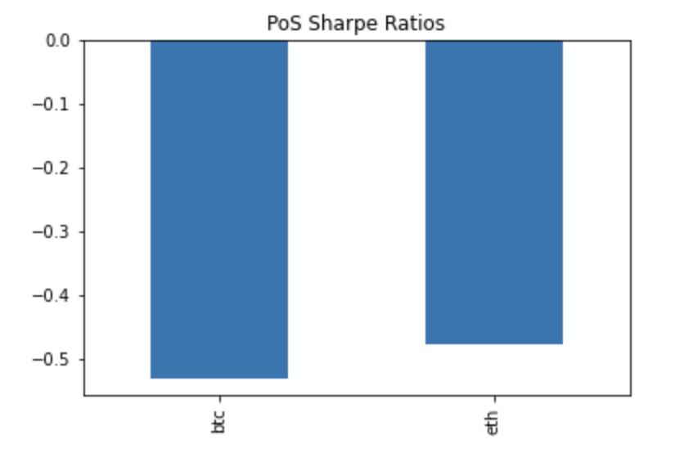
Risk Cont.

Slide 12
Performance & Volatility Comparison

Slide 13
Daily Returns

Slide 14
Portfolio Volume Comparison

Slide 15
Monte Carlo Simulation

Slide 16
Conclusions

Slide 17
Recommendations & Future Research

